Slide 1
Precision Agriculture Plant Classification Using CNNs
Sushika Reddy Gade
1361635
Credits:
Prof. Arup Das

Slide 2
Project Objective
Objective: Built multiple CNN models to classify plant species.
Applied data augmentation, regularization, and transfer learning to improve performance.
Goal: Maximize the F1 score for each model
The objective of this project is to develop a CNN-based classifier to identify plant seedling species
from images, supporting applications in precision agriculture, such as crop management and weed control
The dataset includes images of 12 plant species (e.g., Black Grass, Charlock, Maize, Sugar Beet), with
image data stored in images.npy and corresponding labels in Label.csv. Using Keras, the goal is to design
and train an efficient model capable of accurately classifying these species. Given the dataset size, a GPU
runtime is recommended for faster computation.

Slide 3
Outline of Presentation:
EDA & Preprocessing
Model 1: Basic CNN
Model 2: Enhanced CNN with Augmentation
Model 3: Transfer Learning
Comparison of Models

Slide 4
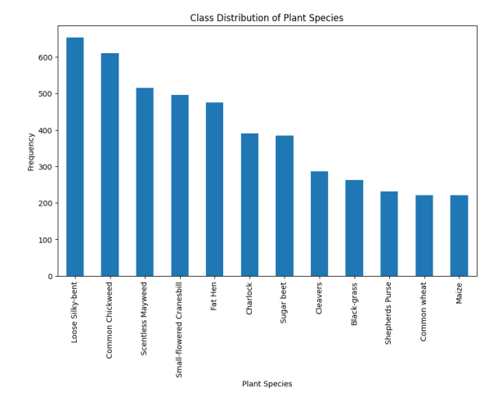
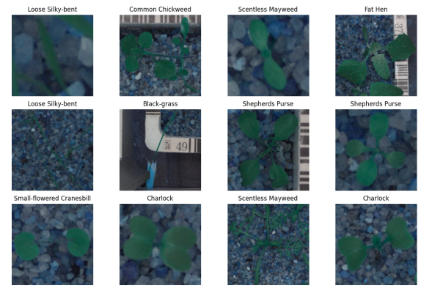
Exploratory Data Analysis (EDA)
Data Analysis & Class Distribution
Multi-panel image plot (3x4 grid) of sample images from the dataset

Slide 5
Class Distribution Skewed As would be observed, the class distribution chart shows how imbalanced the data is,
since there are samples of certain species, such as Loose Silky-bent and Common Chickweed, that, compared with the rest of the species like Maize and Common Wheat, are way higher
So this would probably make a difference in the performance of the model, as it may get overfitted to classes which have more samples
For instance, in the sample images, the seedlings have been set against a background of small stones, which seems consistent across classes.
Certain unique features observed include slight variation in shape, color, and texture of the leaves, which can possibly show the difference between species.
These variations are, however, very minor, therefore suggesting that only a very strong model would be able to identify fine-grained differences for accurate classification.

Slide 6
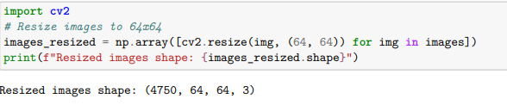
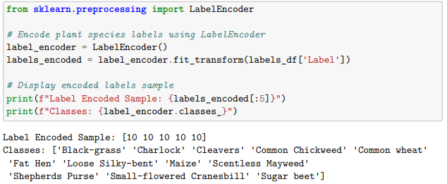
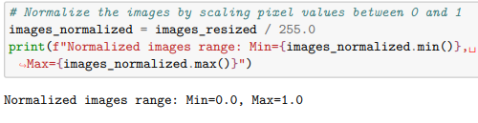
Data Preprocessing Steps
Resizing images from 128x128 to 64x64 reduces computational load and, therefore, increases the training speed with very minimal loss in detail.
Encoding target labels as integers would allow the model to process categories effectively for classification.
Normalization of pixel values to between 0 and 1 stabilizes the training, hence resulting in faster convergence and better performance of the model.

Slide 7
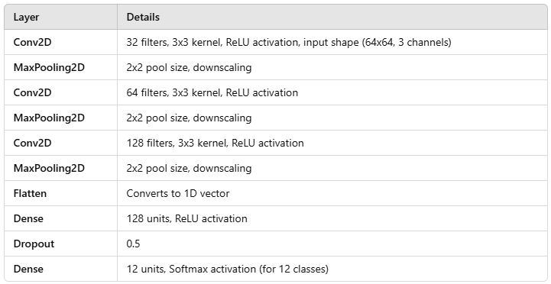
Model 1: Basic CNN Architecture
Optimizer: Adam,
used for multiclass classification.
Loss: Sparse categorical cross-entropy.
Metrics: Accuracy.

Slide 8
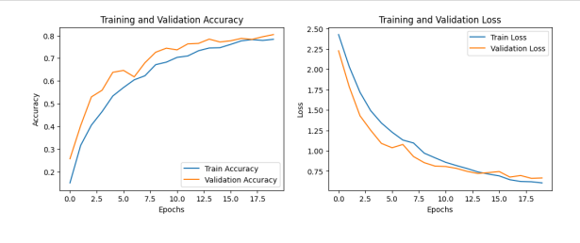
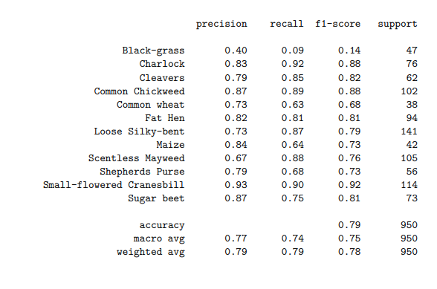
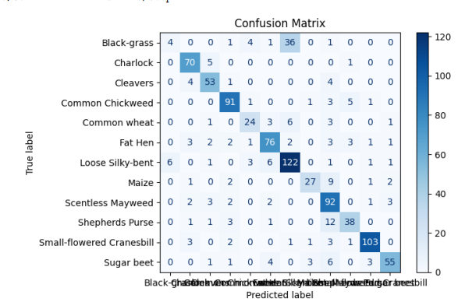
Model 1: Training Performance

Slide 9
Weaknesses
Low Precision and Recall for Certain Classes: Some classes, like
"Black-grass" and "Scentless Mayweed," have low precision, recall, and F1-scores (e.g., F1-score of 0.14 for "Black-grass"). This indicates difficulty in distinguishing these classes, potentially due to class imbalance or overlapping features.
Underfitting Signs: The training and validation accuracy curves are close but do not reach higher values, suggesting that the model might be underfitting. A more complex architecture could better capture intricate patterns.
Class Imbalance Impact: The support column indicates varying sample sizes per class, which could contribute to the model’s biased performance across classes. Classes with fewer samples may benefit from oversampling or synthetic data generation.
Strengths:
High Precision and Recall in Certain Classes: The model shows strong performance for specific classes, such as "Charlock," "Common Chickweed," and "Loose Silky-bent," with precision, recall, and F1-scores generally above 0.80. This suggests that the model is effective in correctly identifying these categories.
Overall Accuracy: The model achieves an overall accuracy of 79%, which indicates reasonable performance for a basic CNN architecture. This level of accuracy may be adequate for initial insights into class separation.
Confusion Matrix Insights: Most predictions cluster correctly along the diagonal in the confusion matrix, showing that the model is able to differentiate well between several classes.

Slide 10
Potential Improvements:
Augmentation and Class Balancing: Apply data augmentation to handle class imbalance and increase representation for underperforming classes.
Advanced Architecture: Experiment with a deeper CNN or add layers like Batch Normalization and additional Dropout to enhance learning capacity and regularization.
Hyperparameter Tuning: Adjust learning rate, batch size, and number of filters in each layer to optimize performance and reduce underfitting.

Slide 11
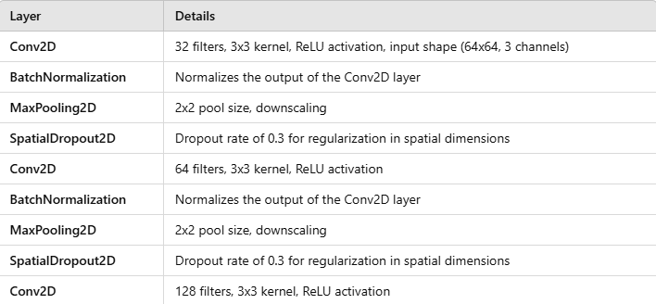
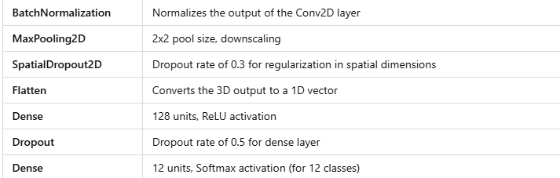
Model 2: Enhanced CNN with Data Augmentation
Optimizer: Adam, used for multiclass classification
Loss Function: Sparse categorical cross-entropy
Regularization Techniques: Batch normalization and spatial dropout

Slide 12
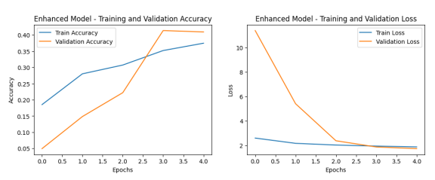
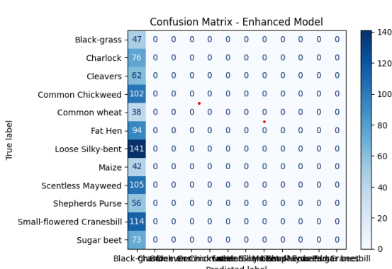
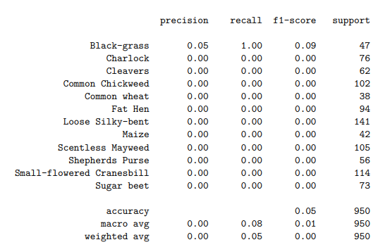
Model 2 - Training Results

Slide 13
The accuracy curve of the enhanced model does not trail off but is very steadily increasing; therefore, the model is learning
although, generally speaking, the accuracy is low.
In validation, accuracy improves more sharply, so there is better generalization compared to Model
There is a marked decrease in the loss cure compared to Model 1,
By incorporating batch normalization, the learning process has steadied because it reduces the internal covariate shift,
which is probably one of the reasons the loss has gone down.
Spatial dropout added to the convolutional layers is appearing to introduce some effective regularization further than basic dropout applied only to dense layers in Model 1.

Slide 14
Persisting Challenges:
Class Imbalance and Low Precision/Recall:
Despite the improvements in the training and validation curves, class-level performance remains poor (e.g., precision and recall close to zero for most classes). The confusion matrix indicates that almost all classes are still predicted incorrectly or rarely predicted at all. This might suggest issues with class imbalance or insufficient model complexity.
Recall and F1-scores remain low for nearly all classes, similar to Model 1, meaning the model still struggles to identify specific categories accurately.
Model 1: The overall accuracy is 0.79 (or 79%).
Enhanced Model: The overall accuracy is 0.05 (or 5%).
This indicates that, although the enhanced model incorporated regularization techniques like batch normalization and spatial dropout, it significantly underperformed compared to Model 1. This drop in performance suggests that the enhancements may not have been well-suited to the data or that further adjustments are needed to the model architecture or training process.

Slide 15
Model 3 - Transfer Learning Setup
Fine-Tuning the Models
VGG16 and ResNet50 were both loaded with pre-trained weights from the ImageNet dataset. This allows the models to leverage pre-learned feature representations from a large dataset, which can be beneficial for our classification task.
Freezing Layers:
All layers in both VGG16 and ResNet50 were frozen to retain the learned features and avoid updating weights in the pre-trained layers during training.
This approach focuses training on the added dense layers rather than modifying the base model, which is effective when the dataset is similar to ImageNet.
3. Adding Custom Layers:
A Global Average Pooling layer was added after the base model output to reduce the feature map’s dimensions.
A Dense layer with 128 units and ReLU activation was included for feature extraction, followed by a Dropout layer with a rate of 0.5 for regularization.
Finally, a Dense output layer with 12 units and Softmax activation was added to classify 12 plant species

Slide 16
Regularization Techniques in the Custom Layers
Dropout: A dropout rate of 0.5 was used after the dense layer to prevent overfitting by randomly dropping half of the units during training.
Hyperparameter Tuning:
The number of units in the dense layer was tuned within a range of 64 to 256, aiming to find the best configuration to optimize model performance.
The tuning process aimed to maximize validation accuracy, as seen in the results where the best validation accuracy reached 0.5789 (or 57.89%).

Slide 17
Model 3: Transfer Learning Performance
VGG16 Model
Overall Accuracy: VGG16 achieved an accuracy of 36%, which is a noticeable improvement compared to the basic CNN models and the ResNet50 model’s 15% accuracy
Class-Level Performance: Precision and Recall:
Some classes, such as “Loose Silky-bent” and “Common Chickweed,” showed substantial gains in recall (e.g., 0.91 for Loose Silky-bent and 0.68 for Common Chickweed). This indicates better recognition of certain classes compared to previous models.
F1-Score: While still low overall, the F1-scores for specific classes improved, with a maximum of 0.53 for Loose Silky-bent and other classes scoring around 0.3 to 0.5.
Confusion Matrix Insights: VGG16 demonstrated fewer misclassifications, and the matrix shows improved differentiation across several categories, indicating that it could learn more distinct class features than the basic CNN models.
ResNet50 Model
Overall Accuracy: ResNet50 achieved a lower accuracy of 15%, which did not outperform the basic models significantly and performed worse than VGG16.
Limited Class Recognition: The confusion matrix shows that ResNet50 failed to classify most classes correctly, resulting in a low recall for nearly all categories.
Possible Overfitting/Underfitting: The training and validation curves for ResNet50 suggest that it may not have adapted well to the dataset, likely due to either limited fine-tuning or architectural mismatches for this classification task.

Slide 18
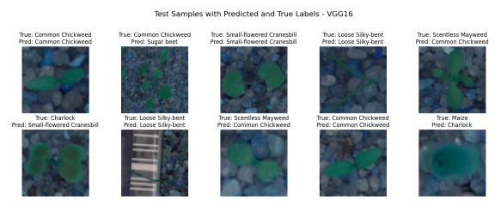
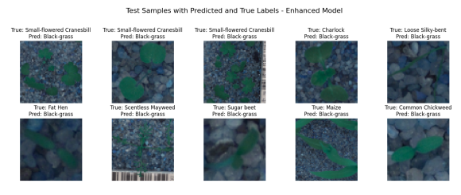
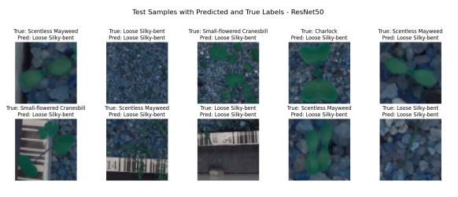
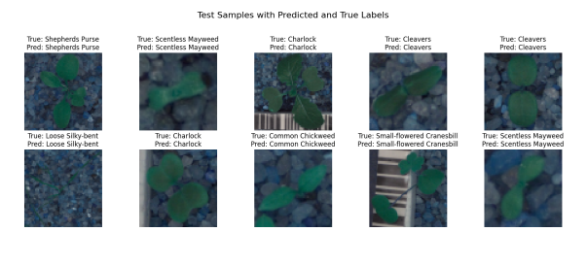
Model Predictions

Slide 19
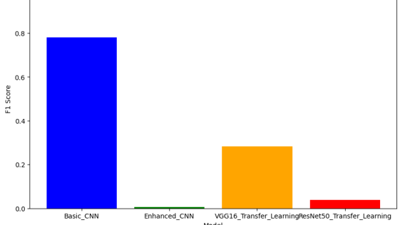

Slide 20
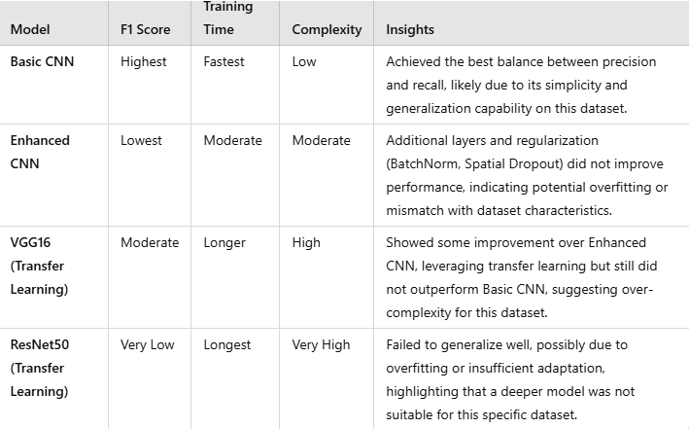
F1 Score Comparison

Slide 21
Key Learnings
Best Model: The Basic CNN due to its balance of simplicity and
effective learning for this dataset.
Trade-Offs: While pre-trained models (VGG16 and ResNet50) brought
more complexity, they were not well-suited to the dataset, leading to longer
raining times without proportional performance gains.
Conclusion:
The Basic CNN, being a simpler model, outperformed more complex models in this task.
This underscores the importance of matching model complexity to dataset size and variety;
simpler models can sometimes
achieve better results on smaller or
straightforward datasets.

Slide 22
Challenges and Solutions
Overfitting: Both the Enhanced CNN and ResNet50 showed signs of overfitting, as seen in poor generalization on validation data. Regularization techniques, such as dropout and spatial dropout, along with batch normalization, were employed to reduce overfitting. For the pre-trained models, freezing the base layers and training only the top layers helped retain useful features while minimizing overfitting.
Class Imbalance: Several classes had low representation, leading to poor recall and precision for those categories. Data augmentation partially addressed this by generating more varied samples, but further techniques (e.g., oversampling or synthetic data generation) could be considered to balance class representation more effectively.
Transfer Learning Adaptation: VGG16 benefited from transfer learning, but ResNet50’s complexity was a challenge. Freezing the initial layers in both models helped, but VGG16 adapted better due to its simpler architecture. This highlighted the importance of choosing a pre-trained model that is appropriately scaled to the task

Slide 23
Thank You ☺

